Slide 1
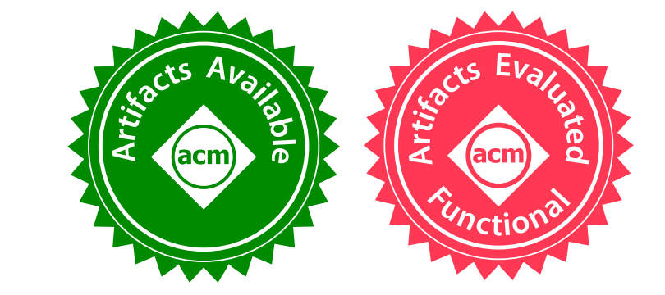

Towards Automated Verification of Smart Contract Fairness
Ye Liu, Yi Li, Shang-Wei Lin, Rong Zhao
Nanyang Technological University
Singapore
Notes:
Hello, everyone, my name is Liu Ye, from Nanyang Technological University, Singapore.
Today I will present our work on automated verification of smart contract fairness.
This is a collaboration work with Yi LI, Shang-Wei Lin and Rong Zhao from NTU.

Slide 2
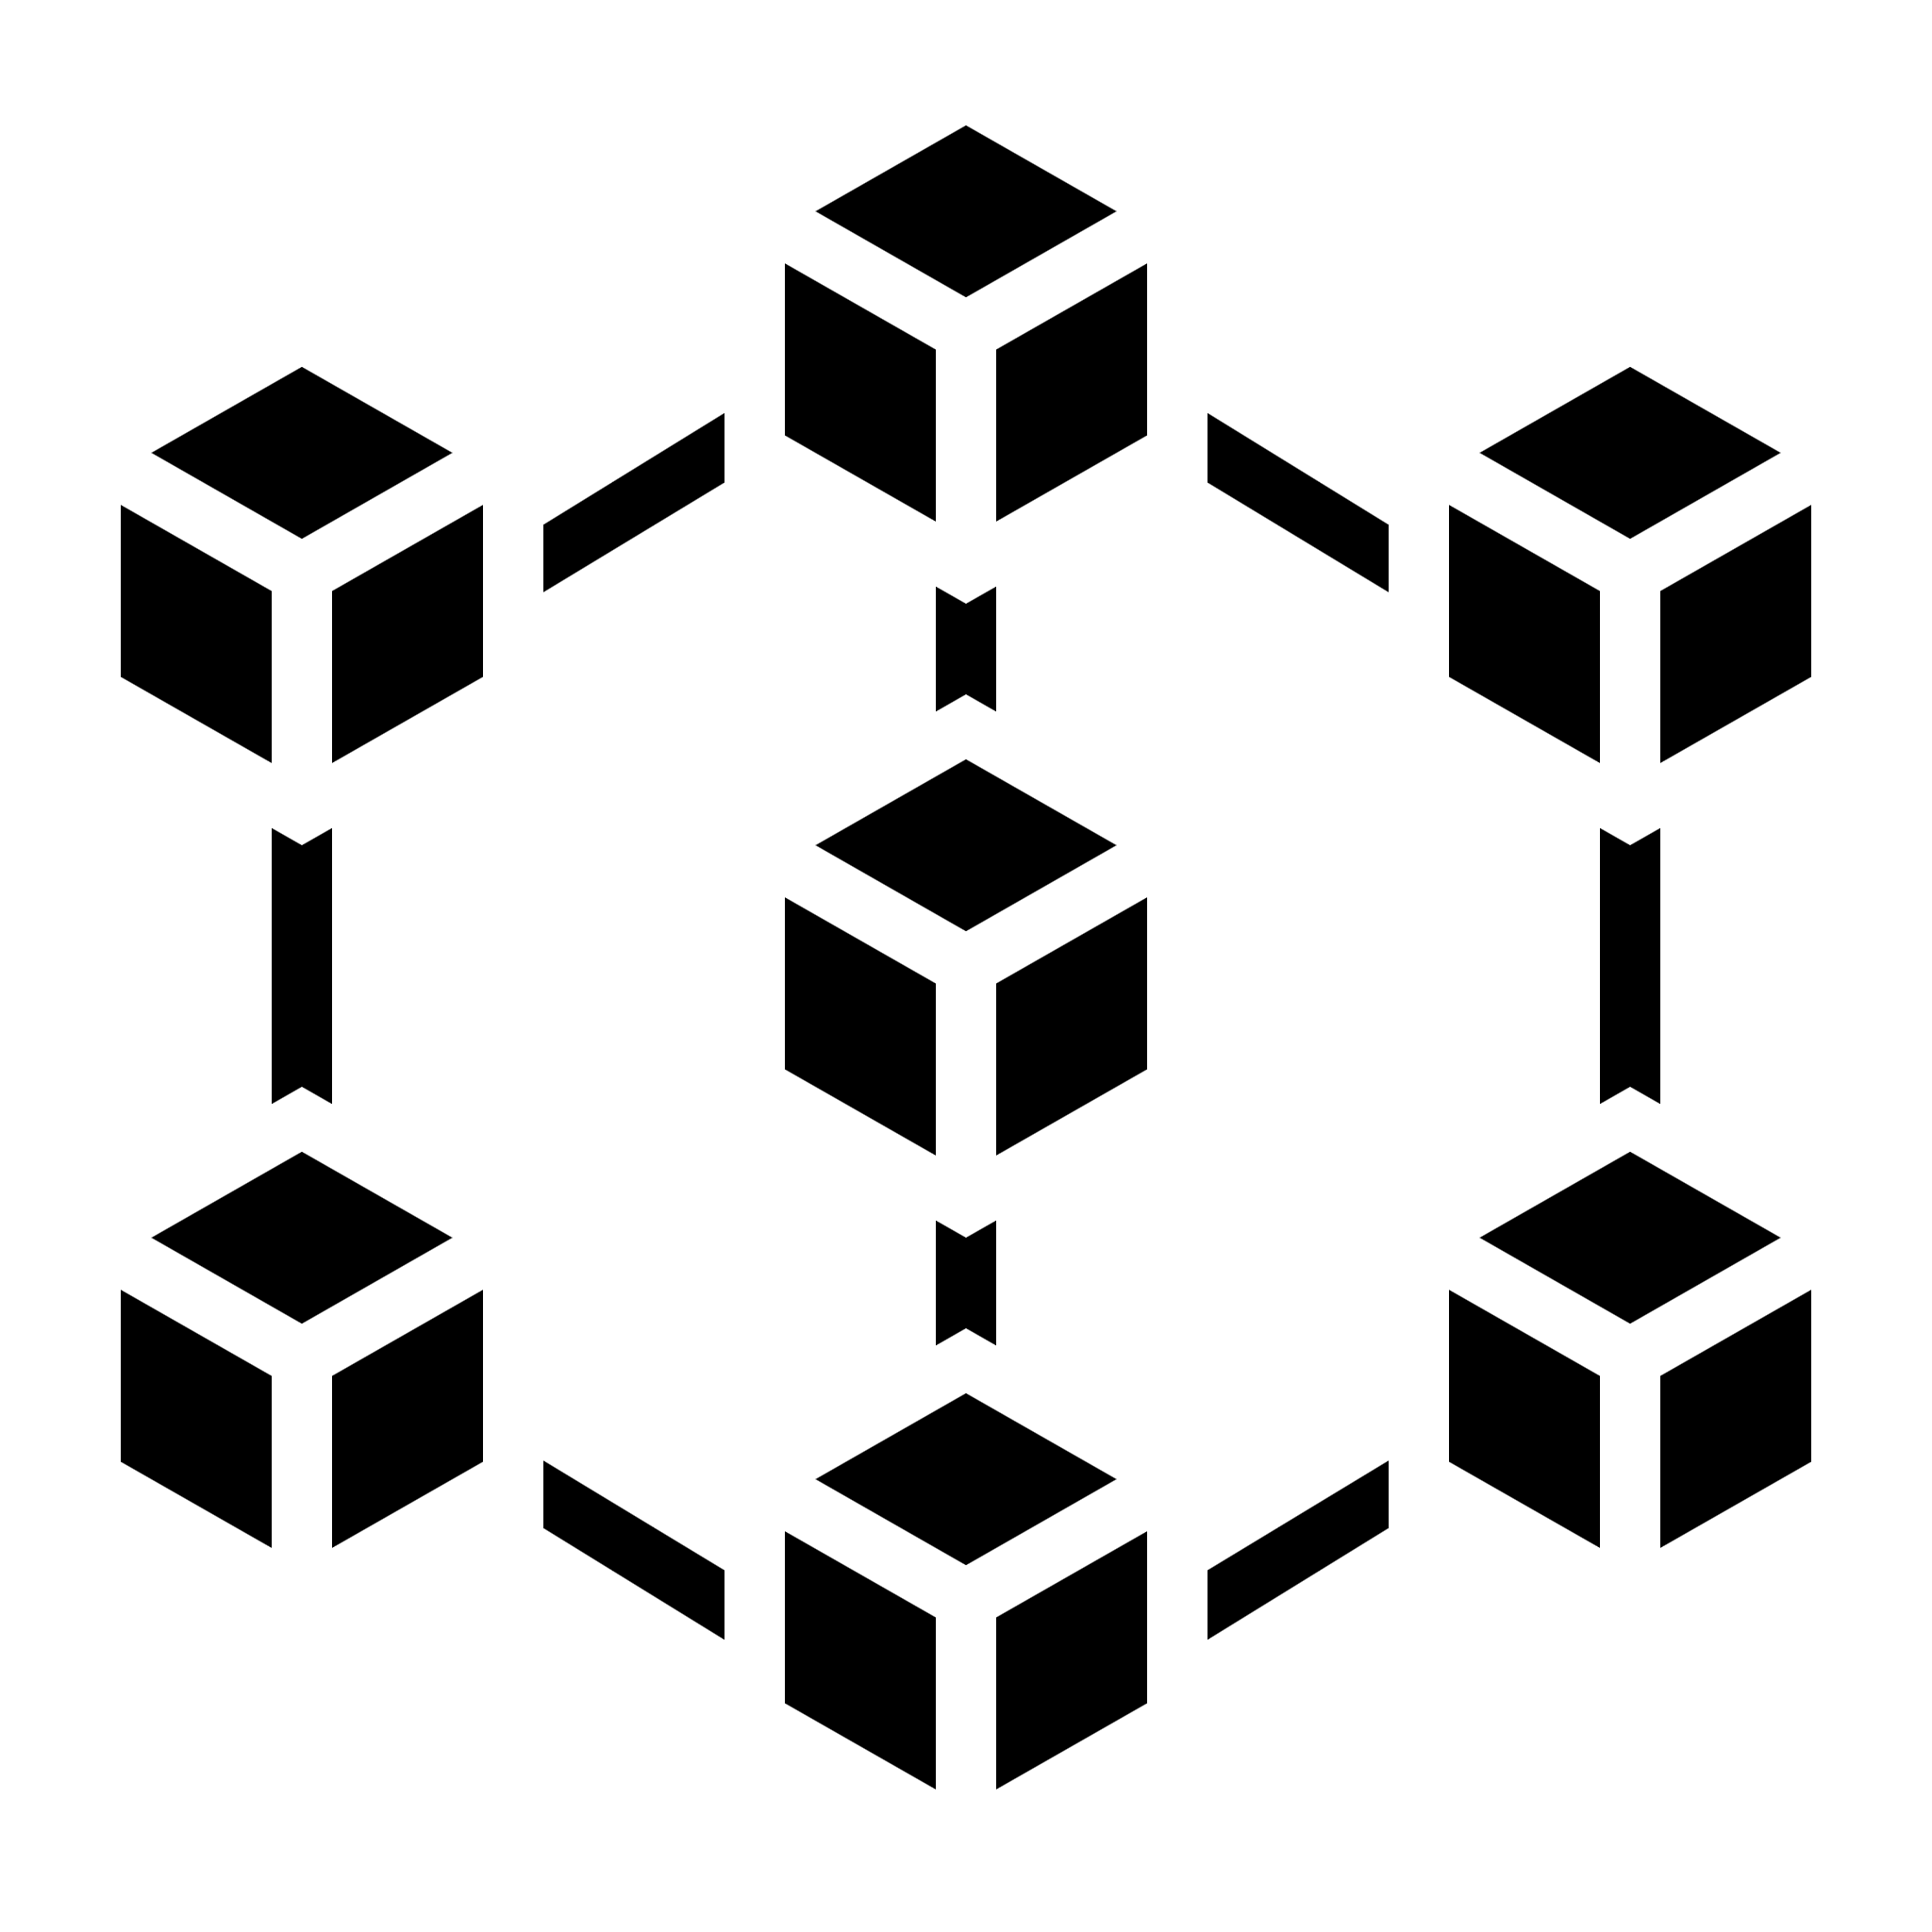
Smart Contracts
Nick Szabo, 1996 first coined the term as ``a set of promises, specified in digital form, including protocols within which the parties perform on these promises”
Smart contracts are computer programs running on blockchain platforms
Users
Smart Contract
Execution
Blockchain
Notes:
Let me briefly introduce smart contracts.
What is smart contract, in 1996, Nick Szabo [sa’:bo] first proposed this concept.
A smart contract has a set of components.
“a set of promises, specified in digital form, and protocols where the different parties perform on these promises”
Nowadays, Smart contracts are usually considered as computer programs running on blockchain platform.
As users, they can interact with smart contracts by sending transactions to blockchain.
The transactions will be processed by blockchain and enforce the execution of smart contract functions.
Blockchain will record the contract execution result and remain immutable.
//which makes smart contracts suitable for trustless scenarios.

Slide 3
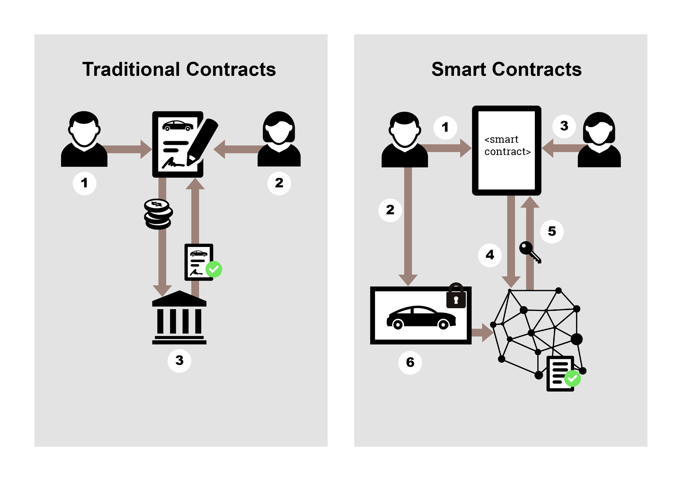
Car Selling and Buying via Smart Contract
Traditional Contracts
Relying on intermediaries
Non-transparent
Slow and costly
Smart Contracts
Immutable
Self-enforcing
Affordable and accessible
https://www.linkedin.com/pulse/real-world-example-smart-contract-marvin-felder/
Notes:
So, Why smart contracts.
Let’s suppose Alice want to buy a car from Bob.
In traditional way, Alice and Bob need to sign a paper contract.
The paper contract will be enforced by trusted intermediaries to transfer the car ownership.
However, in smart contracts, Alice and Bob don’t need to trust a third party.
The car ownership transfer process can be automatically enforced in smart contracts, which is faster than the traditional contracts.
Blockchain guarantees the transparency and integrity of this happened transaction, so that nobody can revert the transaction.

Slide 4
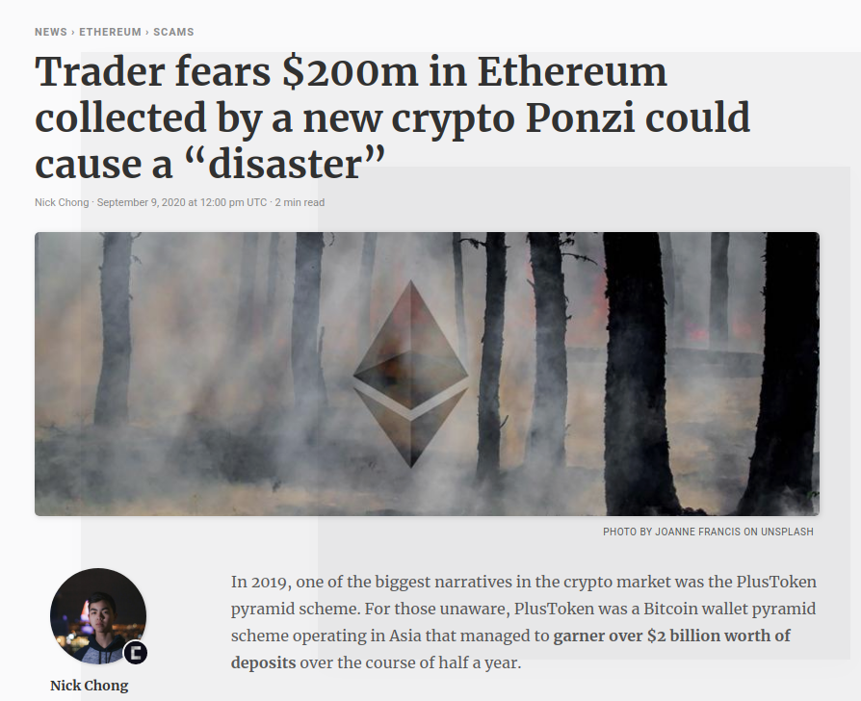
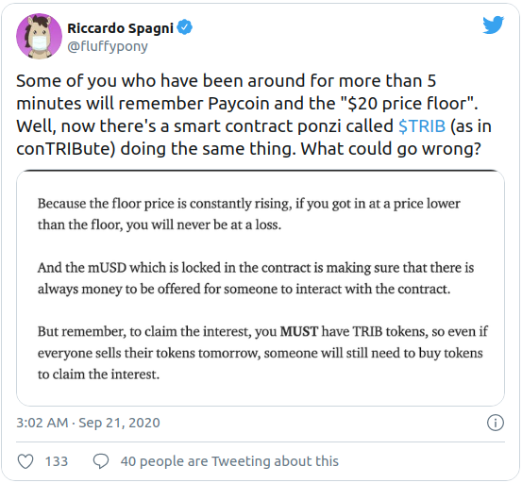
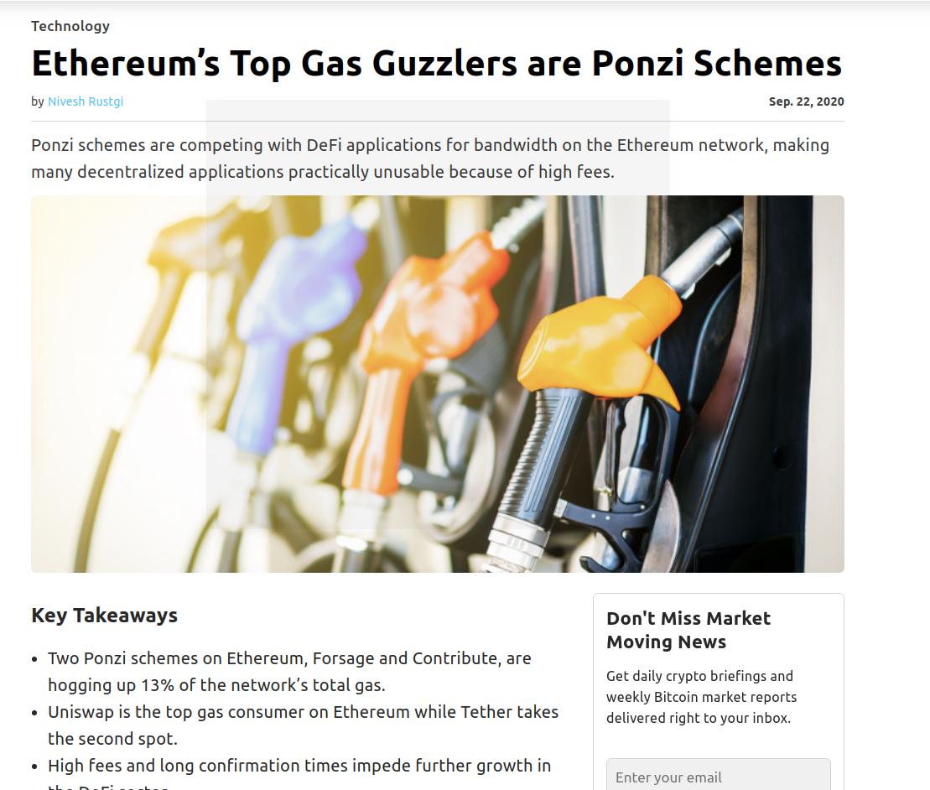
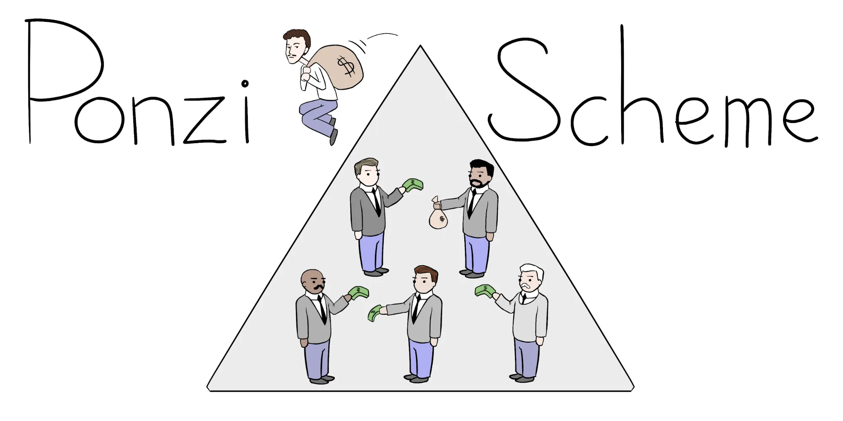
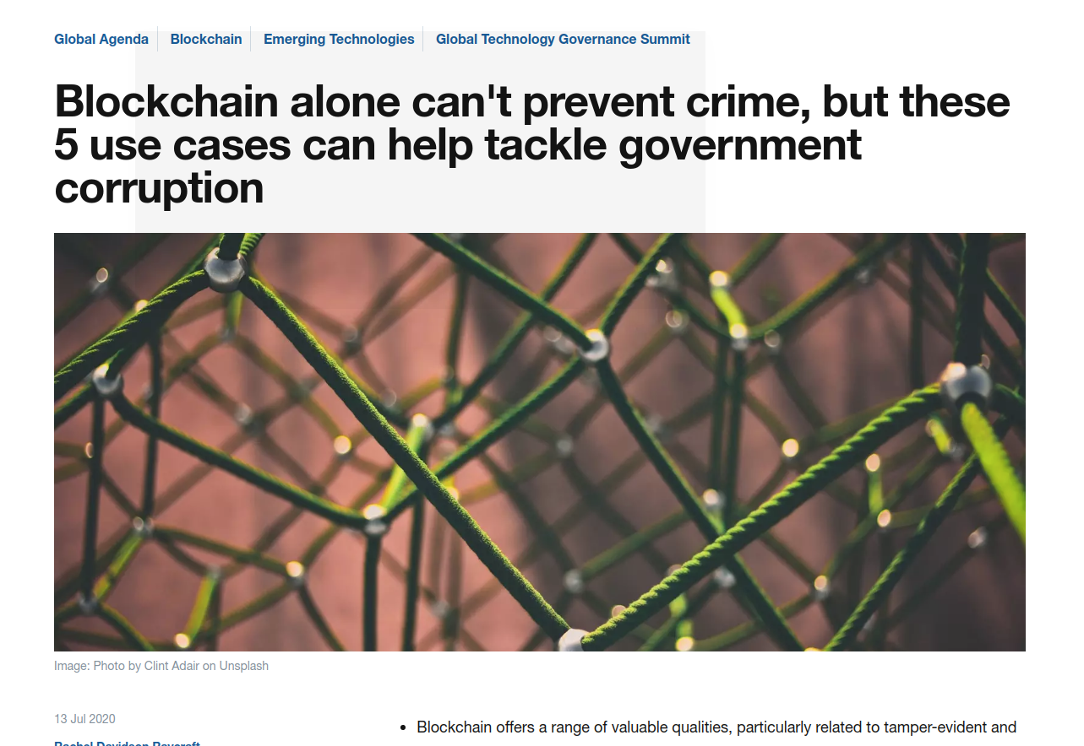
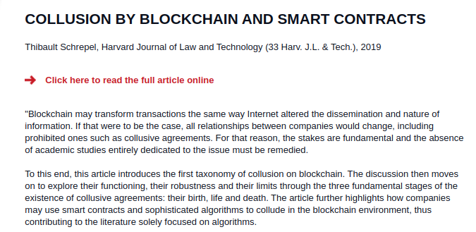
Fairness Issues
Public Procurement
Land Title Registries
Electronic Voting
Beneficial Corporate Ownership Registries
Grant Disbursements
Image curtsey: https://timesofindia.indiatimes.com; https://farming.co.uk
Notes:
But, fairness issues can exist in smart contract.
Fairness means if someone can gain advantage over others.
For example, the most infamous one is the Ponzi scheme.
Ponzi Schemes have been widely observed on Ethereum Smart Contract.
Moreover, Collusion in Smart Contract also poses threat to smart contract fairness.
especially for auctions and electronic votings.
//A Ponzi scheme is a form of fraud that lures investors and pays to earlier investors with funds from more recent investors.

Slide 5
Contents
Smart Contract Background
Fairness Issues in Smart Contract
FairCon: Fairness Verification Framework
Evaluation
Notes:
For the remaining part of the talk, I will demonstrate the fairness issues of a concrete smart contract example.
Then, I will present the fairness verification framework and our evaluation results.

Slide 6
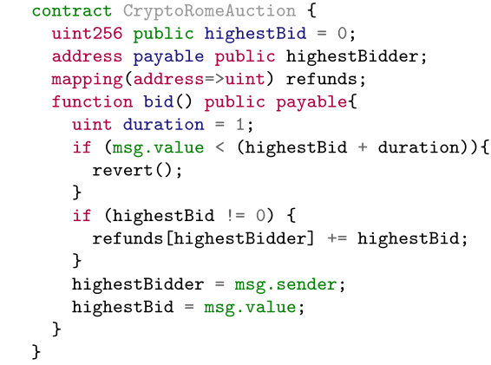
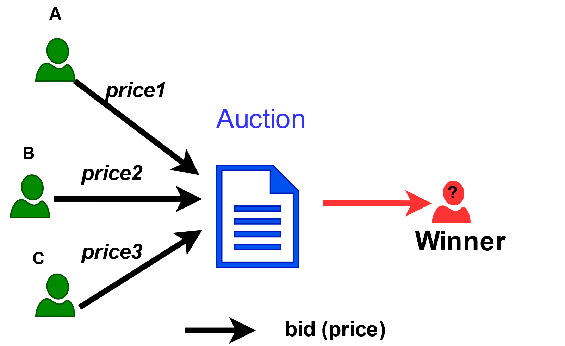
An Auction Smart Contract
Bidder | Valuation
A | 3
B | 4
C | 6
Open to all bidders
highestBidder wins the auction
Latecomer wins when bidding $1 more than the highestBid
Notes:
Here is a real world auction contract, CryptoRomeAuction.
The contract was written in Solidity, a popular smart contract programming language.
This contract implements an open auction.
-- the highest bidder wins the auction and
- the late comers can win if they bid one dollar more than the highest bid.
For an auctioned item, at the start of bidding, every bidder may have different valuation.
Given three bidders A, B, C,
A thinks the item valued 3 dollars, B thinks the item valued 4, and C thinks the item valued 6.
Notice that the bid price made by the bidder could be different from his valuation.

Slide 7
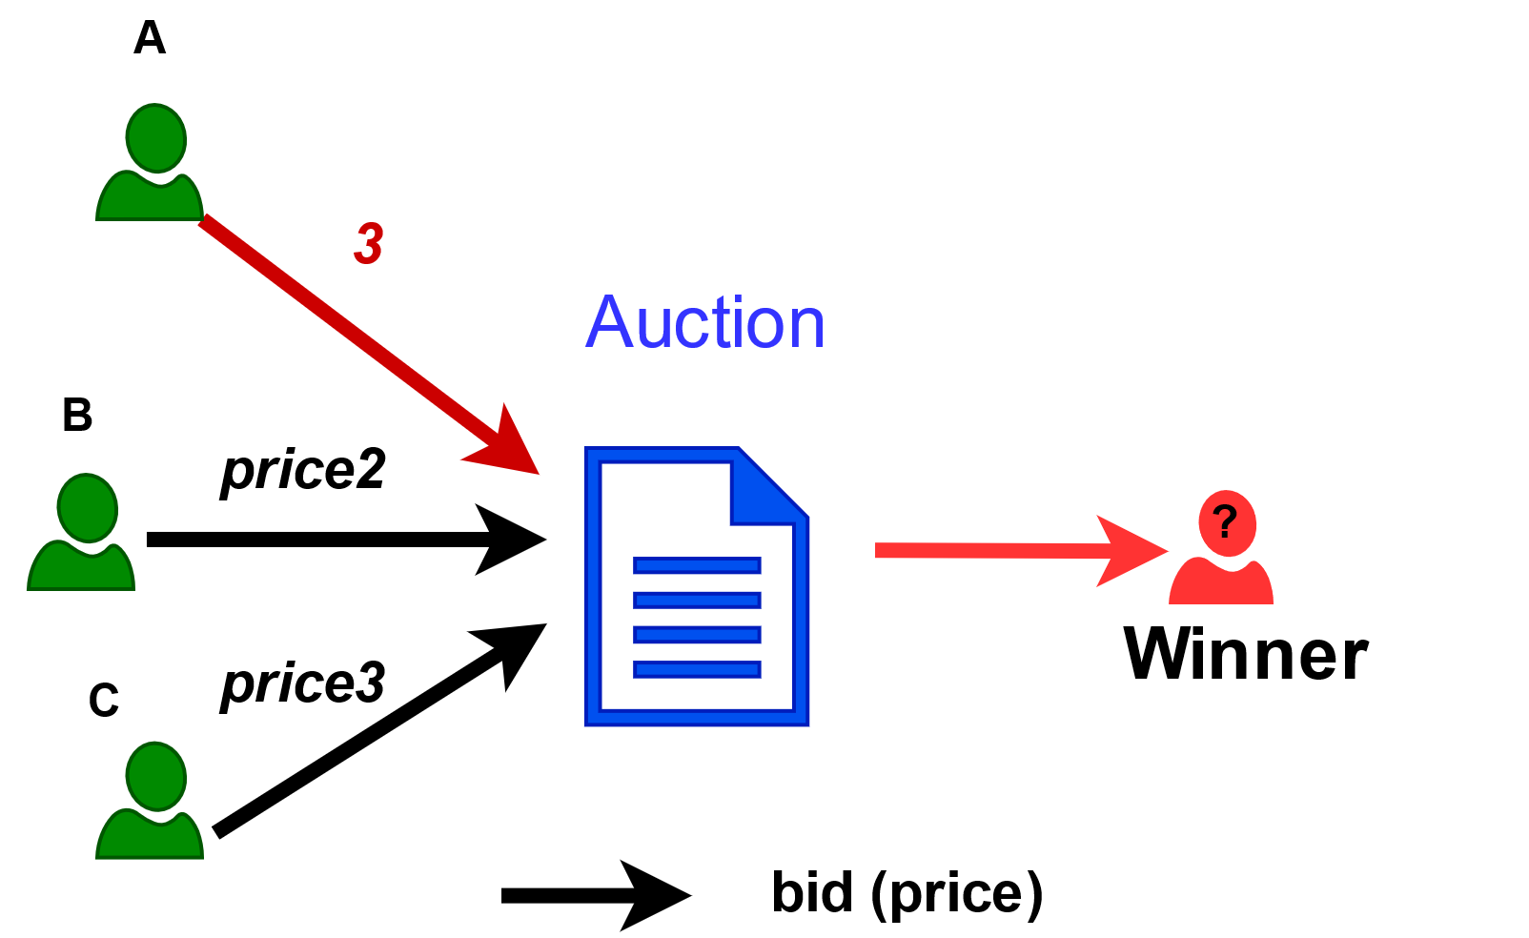
An Auction Smart Contract
Bidder | Valuation
A | 3
B | 4
C | 6
Open to all bidders
highestBidder wins the bid
Latecomer wins when bidding $1 more than the highestBid
3
A
3
3
0
1
Notes:
Suppose, User has a bid price 3.
To do that, the user calls the bid function;
then the condition rule inside the function will be checked.
Since the condition failed,
the next statement will be executed.
In the end, the contract updates the highest bidder to user A, the current highest bid to 3 dollar.

Slide 8
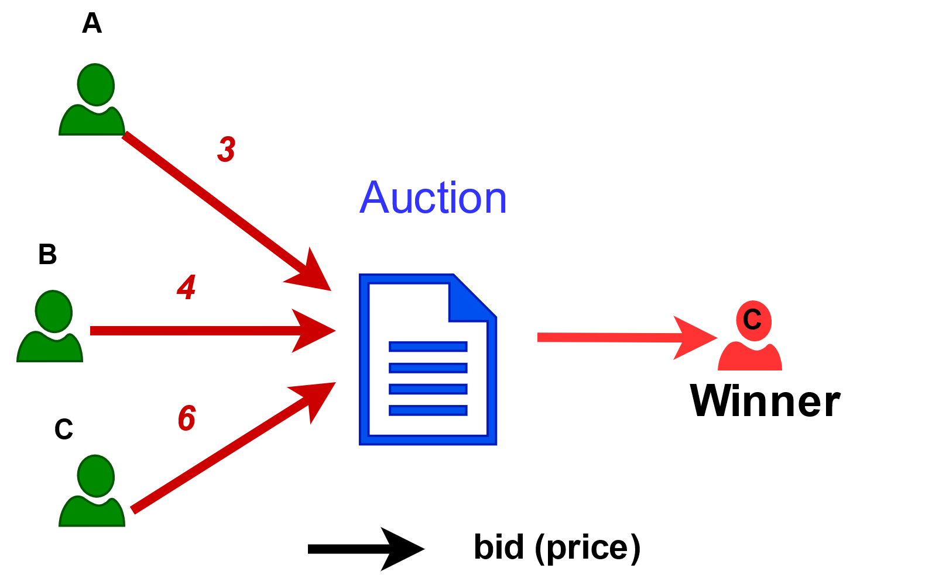
An Auction Smart Contract
Open to all bidders
highestBidder wins the bid
Latecomer wins when bidding $1 more than the highestBid
Bidder | Valuation | Bid Price
A | 3 | 3
B | 4 | 4
C | 6 | 6
3
6
C
4
6
C wins, and pays $6
Notes:
Similarly, user B, and user C can bid and update the variables: highest bidder and highest bid accordingly.
User B bids 4 and user C bids 6.
Finally, user C wins the auction and pays 6 as the auction clear price.
However, user C can pay less money to win the auction.

Slide 9
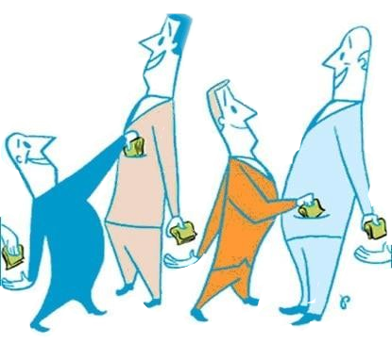
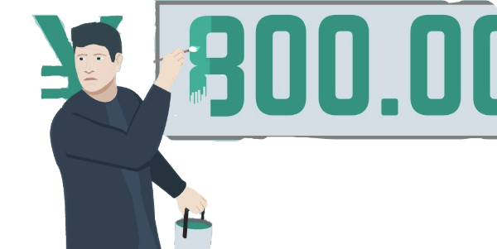
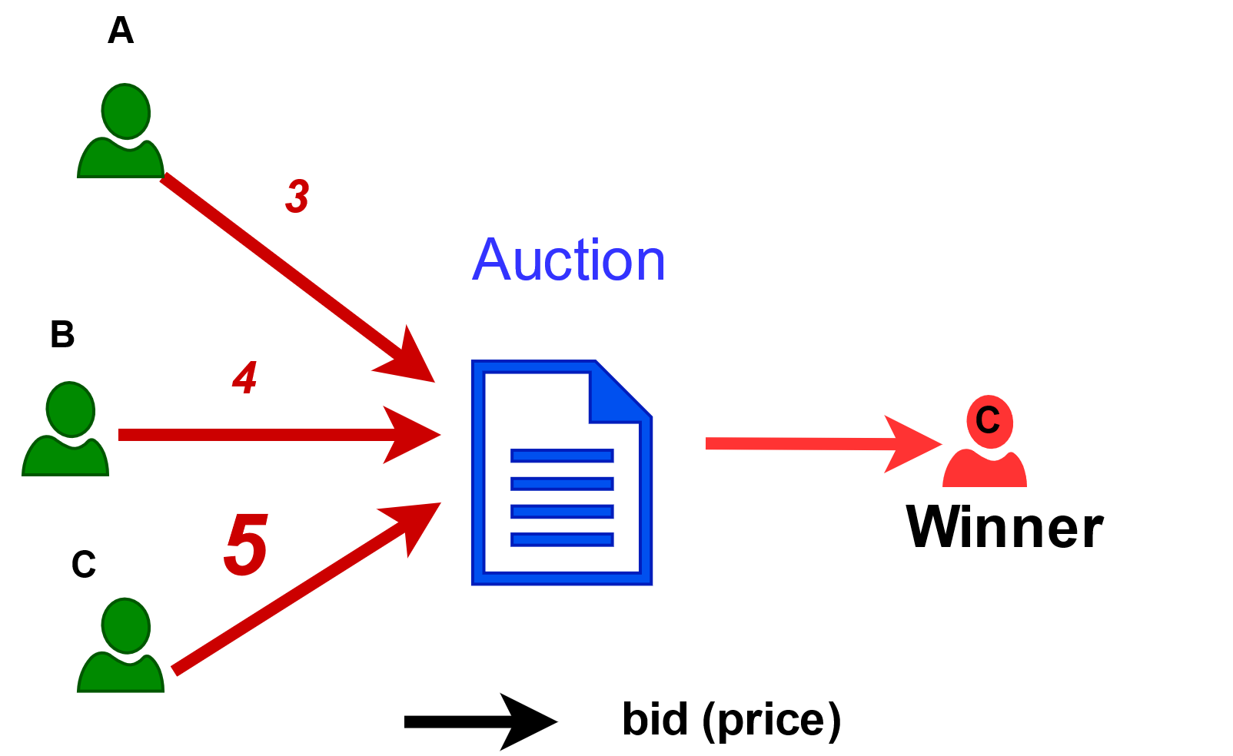
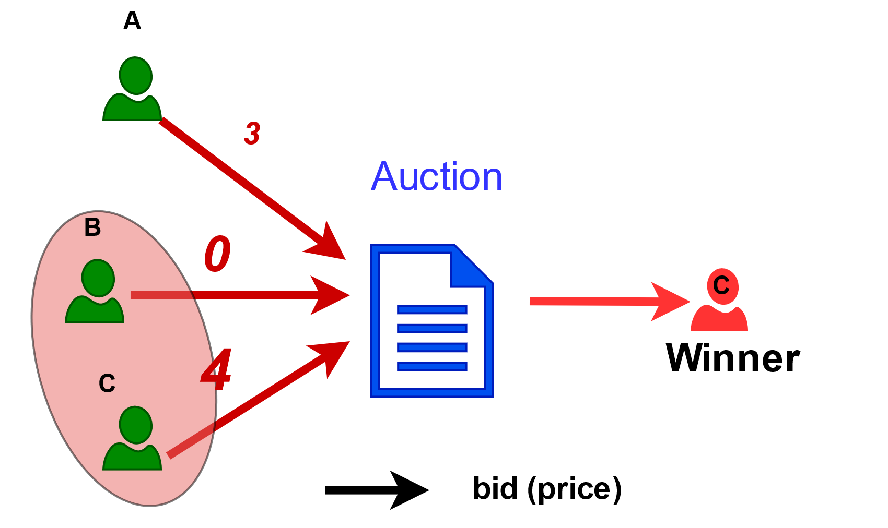
Threats to Smart Contract Fairness
Bidder | Valuation | Bid Price
A | 3 | 3
B | 4 | 0
C | 6 | 4
Bidder | Valuation | Bid Price
A | 3 | 3
B | 4 | 4
C | 6 | 5
1. Untruthful behavior
2. Collusion among players
3
4
C wins, and pays $5
C wins, and pays $4
Notes:
When user C is untruthful, C bids less than his valuation on the auction.
User C wins the auction. And only pay 5 dollar.
Moreover, the worst case is that user C colludes with user B, now user B bids 0, user C bids 4.
Finally, user C will win the auction but pay much less, at 4 dollar.
Apparently, these behaviors are not fair for user A, who acts honestly.

Slide 10
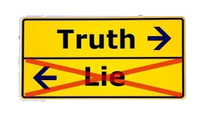



Smart Contract Fairness Verification
(Other fairness properties:
2-collusion freeness, optimality, efficiency)
Automated Checker
Smart Contract
Image curtsey: https://www.needpix.com/photo/185086/
Notes:
To find these fairness issues, we proposed an automated checker to verify if a smart contract satisfies a fairness properties.
As fairness could be too subjective,
we restrict to four fairness properties defined in game theory or say mechanism design theory.
The details can be checked in our paper.
We treat smart contracts as games between users and developers.
The verification result either indicates the contract is unfair through some counterexamples or fair using bounded property checking or unbounded verification.
I will show how we achieve that.

Slide 11
Fairness Verification Framework (FairCon)
Instrumented harness program
Legend
Generate symbolic paths
Synthesize mechanism model
Translate to SMT encoding
Input
Model Extraction
Process
Counter-examples
failure
Instrument
contract (k-player)
Data
Unfair
Check fairness property P
k-player bounded model
Property Checking
Examples
success
Result
Smart Contract +
Fairness Property p
success
Fair
Example-guided invariant generation
Verification conditions
Prove fairness property P
Predefined invariant templates
Unknown
Fairness Proof
failure
Three stages: model construction, property checking, fairness proof.
Notes:
This is our fairness verification framework, we called it FairCon.
There are three main stages: model construction, property checking, and fairness proof.
FairCon takes the smart contract code, fairness property to be checked, and invariant templates as the inputs.
We use symbolic execution technique and bounded property checking to try to find counterexamples.
We also explore the loop invariants to prove fairness property if there are no counterexamples in our checking.

Slide 12
Fairness Verification Framework (FairCon)
Instrumented harness program
Legend
Instrumented harness program
Generate symbolic paths
Synthesize mechanism model
Generate symbolic paths
Synthesize mechanism model
Translate to SMT encoding
Translate to SMT encoding
Input
Model Extraction
Process
Counter-examples
failure
Instrument
contract (k-player)
Data
Instrument
contract (k-player)
k-player bounded model
Unfair
Check fairness property P
k-player bounded model
Property Checking
Examples
success
Result
Smart Contract +
Fairness Property p
Smart Contract +
Fairness Property p
success
Fair
Example-guided invariant generation
Verification conditions
Prove fairness property P
Predefined invariant templates
Unknown
Fairness Proof
failure
First stage: Construct K-player mechanism model behind smart contract
Notes:
At the first stage, we have a smart contract, given fairness property, we instrument the K-players environment into the smart contract.
We get a harness program,
then we use symbolic execution to execute this harness program.
The symbolic paths will be synthesized to construct the bounded mechanism model through SMT encoding.
The reason why we use the K-players environment is that many unfair smart contracts can be revealed using a small number of players.

Slide 13
Fairness Verification Framework (FairCon)
Instrumented harness program
Legend
Generate symbolic paths
Synthesize mechanism model
Translate to SMT encoding
Input
Model Extraction
Process
Counter-examples
failure
Counter-examples
Data
Instrument
contract (k-player)
k-player bounded model
Check fairness property P
k-player bounded model
Unfair
Check fairness property P
Unfair
Property Checking
Examples
Result
Examples
success
Smart Contract +
Fairness Property p
success
Fair
Example-guided invariant generation
Verification conditions
Prove fairness property P
Predefined invariant templates
Unknown
Fairness Proof
failure
Fairness Proof
Second stage: Fairness properties checking
Notes:
At this stage, we perform property checking on the bounded model.
We will check specific fairness properties.
If we find counterexamples, the contract is unfair.
Otherwise, there will be some positive examples to help us prove the fairness property.

Slide 14
Fairness Verification Framework (FairCon)
Instrumented harness program
Legend
Generate symbolic paths
Synthesize mechanism model
Translate to SMT encoding
Input
Model Extraction
Process
Counter-examples
failure
Instrument
contract (k-player)
Data
Unfair
Check fairness property P
k-player bounded model
Property Checking
Examples
Result
Examples
success
Smart Contract +
Fairness Property p
Smart Contract +
Fairness Property p
success
Fair
Fair
Verification conditions
Example-guided invariant generation
Verification conditions
Prove fairness property P
Example-guided invariant generation
Prove fairness property P
Predefined invariant templates
Fairness Proof
Predefined invariant templates
Unknown
Unknown
failure
Fairness Proof
Last stage: The proof of fairness properties
Notes:
At the last stage, we use invariant techniques to prove the fairness property.
Among the predefined invariant templates, we can identify the invariant candidate from the positive examples.
We use Dafny to verify if these invariant candidates hold.
If invariants exist, we can check the conditions of fairness property and then prove it.
Once proved, the contract is fair. Otherwise, the fairness remains unknown.
More implementation details can be checked in our paper.

Slide 15
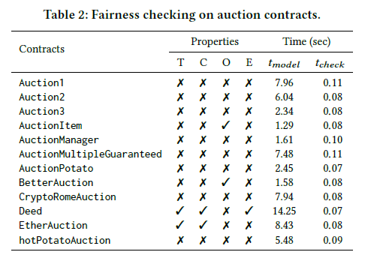
Evaluation of Property Checking
3-player mechanism models
12 real-world auction smart contracts
T: truthfulness C: 2-collusion-freeness O: optimality E: efficiency
8 contracts do not meet our fairness properties
4 contracts meet some properties
Notes:
We evaluate our framework, FairCon, on 12 real world auction smart contracts.
The basic setting is 3-player mechanism models.
We found there are 8 contracts do not meet any of our fairness properties and 4 contracts meet some properties

Slide 16
Evaluation of Property Checking
3-player mechanism models
12 real-world auction smart contracts
T: truthfulness C: 2-collusion-freeness O: optimality E: efficiency
Around 0.1 second in Property Checking
Notes:
Moreover, the time used in property checking is very small, around 0.1 second for these 3-player mechanism models.
To study the efficiency of property checking, we expanded our evaluation on mechanism models of more than 3 players.

Slide 17
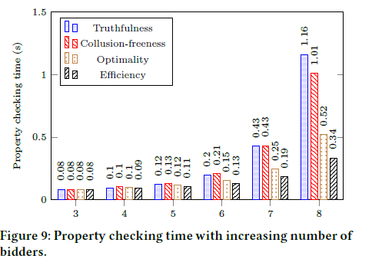
Evaluation of Property Checking Time
From 3-player to 8-player mechanism model
Checking time less than one second
Notes:
We increased the bidder number from 3 to 8. We found the property checking time increases slightly.
Generally, checking time is less than one second. This indicates our property checking is efficient.

Slide 18
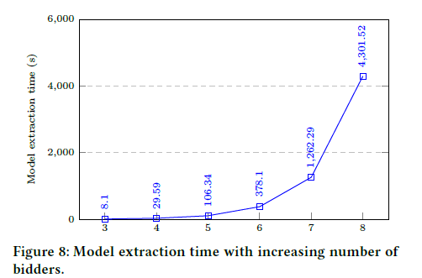
Evaluation of Model Extraction Time
From 3-player to 8-player mechanism model
Extraction time explodes
Fairness checking does not work for large N
Notes:
We also observed the time used to extract the mechanism model. We found the extraction time increased nearly exponentially.
Path explosion problem.
Therefore, fairness checking does not work for a large number of players. Which requires us to use invariants techniques to prove fairness property.

Slide 19


Evaluation of Fairness Proof
Four “fair” contracts (having no counter-examples)
Contracts | Invariants | Fair
AuctionItem
Deed
EtherAuction |  | ?
BetterAuction
3 contract are fair
1 contract is unknow
More invariant templates should be provided
此照片，作者: 未知作者，许可证: CC BY-SA
Notes:
This is our evaluation to prove fairness properties of four contracts that meet some properties.
For 3 contracts, we found the invariants and proved their fairness properties.
Due to the lack of invariants, one contract is unknown regarding the fairness property.
In the future, users can provide other feasible invariant templates to enhance the proof ability of FairCon.

Slide 20
Summary
(other fairness properties:
2-collusion freeness, optimality, efficiency)
Automated Checker
Smart Contract
Open-sourced at: https://github.com/ntu-SRSLab/FairCon
Notes:
To conclude, in this work, we aim to automatically verify the fairness properties of smart contracts.
There are four fairness properties related to mechanism design theory.
We use bounded property checking to try to find counterexamples against fairness properties and loop invariants to prove fairness properties.
Moreover, our work can be extended by introducing more invariant templates or fairness properties.

Slide 21
Backup

Slide 22
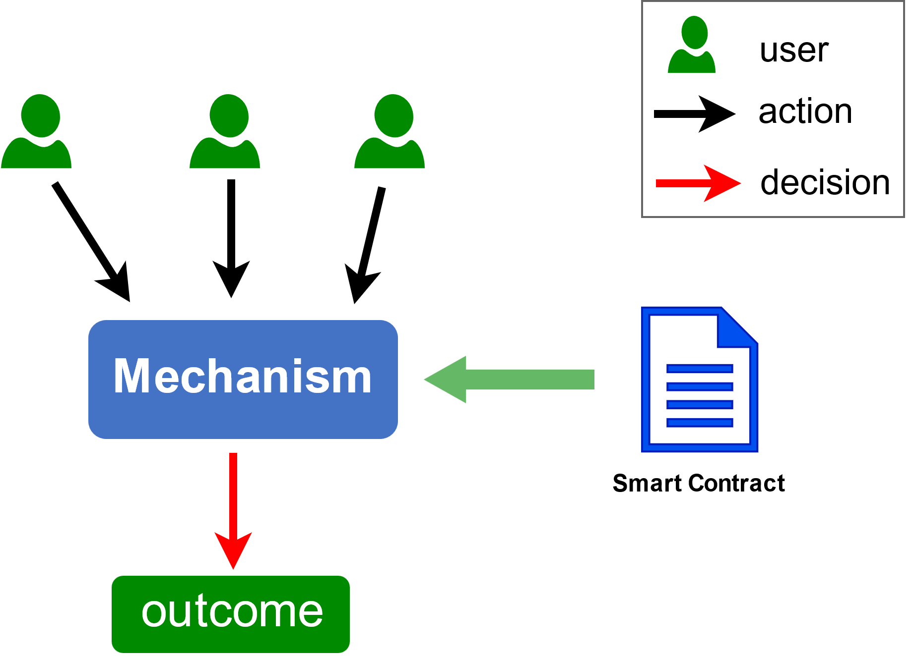
Mapping Smart Contract into Mechanism Models
Allocation function
Who is the winner?
Transfer (pricing) function
How much should winner pay?
Notes:
A mechanism is a set of decision rules that generate outcomes.
Smart Contract also defines a set of rules inside functions to decide what users can get.
We can easily map smart contracts into mechanisms.
Given a mechanism. users will be required to take some action as input. The mechanism will generate the outcome based on the input.
As for the outcome, there exists an allocation function to show who is the winner and a transfer function to calculate how much the users pay.
Usually, only the winner should pay the money.

Slide 23
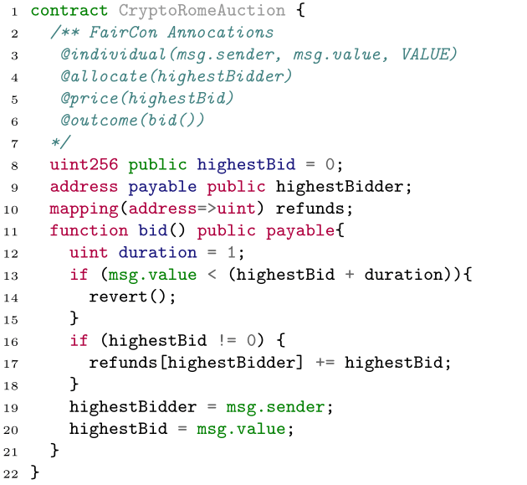
Smart Contract in Mechanism Design
label individual, outcome rule, allocation function and pricing function
Notes:
We can identify the mechanism components in smart contracts.
We take the message sender as the individual, and the message value is the price of the auction.
We also take the highest bidder as the allocation and highest bid as the auction clear price.
And the outcome rule is the bid function.
Let’s see how to analyze the mechanism model of smart contracts.

Slide 24
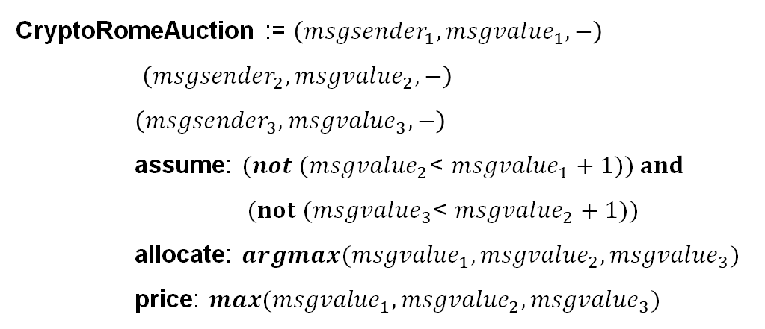
Case Study for Smart Contract’s Mechanism Model
3-player mechanism model
CryptoRomeAuction := $\left({msgsender}_{1},{msgvalue}_{1},−\right)$
$\left({msgsender}_{2},{msgvalue}_{2},−\right)$
$\left({msgsender}_{3},{msgvalue}_{3},−\right)$
assume: $(not ({msgvalue}_{2}$< ${msgvalue}_{1}+1)) and$
$(not ({msgvalue}_{3}$< ${msgvalue}_{2}+1))$
allocate: $argmax({msgvalue}_{1},{msgvalue}_{2},{msgvalue}_{3})$
price: $max({msgvalue}_{1},{msgvalue}_{2},{msgvalue}_{3})$
Notes:
Here is a 3-players mechanism model of smart contract.
In the model, there are three bidders: message sender 1, 2, 3 and different bid prices: message value 1, 2, 3.
We use the assume keyword to represent the condition rule in the bid function.
The rule is the latecomer's bid price is 1 dollar more than the previous one.
The model also shows the allocation is awarded to the bidder with the highest bid price.
And the payment is the highest bid price. Based on the mechanism model, we can check our fairness properties.

Slide 25
Check Truthfulness property of CryptoRomeAuctionn
3-Player
Mechanism Model
all bidders
truthful
price1 = val1
price1’ = val1
bidder3
untruthful
price2 = val2
price2’ = val2
price3 = val3
price3’ != val3
SMT Encoding
assert(and
(>= price2 (+ price1 1))
(>= price3 (+ price2 1))
(>= price3’ (+ price2 1))
(>= (- val3 price3) (- val3 price3’))
)
Truthfulness
Notes:
Take truthfulness as an example. We have two different bid price settings.
In the first setting, all bidders are truthful since their bid prices are equal to their valuations.
In the second setting, only the third bidder is untruthful.
We get a truthfulness formula using SMT encoding.
Briefly, this is an assertion that the difference between valuation and price of truthful setting must be no less than that of untruthful setting.
We can use any SMT solver to check this formula.
We find counterexamples so that truthfulness doesn’t hold for this contract.
Further, if the properties of smart contracts need proving, we should work on unbounded mechanism models.

Slide 26
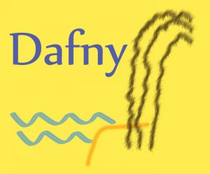
Proof: from k-player to n-player
ALLOCATE = argmax(BID) (TopBidder)
PRICE = max(BID) (1st-Price)
PRICE = max(BID\{BID[argmax[BID]}) (2nd-Price)
Verifier
Find Invariants
unverified
verified
K-players' Model
Check Property
unknown
Fair
Smart Contract
unfair
Counter Examples
Property Checking
Notes:
We use loop invariants to direct the fairness property proof on unbounded models.
We have three invariants. One for allocation function, the other two are for pricing function.
Topbidder means the winner is the bidder with the highest bid price.
First-Price means the winner should pay the highest bid price.
Second-Price means the winner should pay the second highest bid price.
We use Dafny to verify the invariants candidates on smart contracts. If invariants exist, we can prove the fairness property straightforward.
In some cases, invariants are missing, so the contract’s fairness is unknown.

